Slide 1
Compositionality Entails Sequentializability
Pranav Garg, P. Madhusudan
University of Illinois at Urbana-Champaign

Slide 2
What is Sequentializability ?
C
S
Conc. program Seq. program
N shared vars O(N) shared vars L local vars/thread O(L) local vars/thread
Sequentialization requires that the size of sequential program is of the same order as the size of concurrent program.
- The constant in O(N) and O(L) must be independent of #threads.
For non-recursive concurrent programs, global simulation is always possible to obtain a sequential program.
- Leads to a state-space explosion (L^{n} where n is #threads)
- Is not a sequentialization.
Recursive programs are even harder.

Slide 3
Why are sequentializations appealing ?
Practically
Allows the use of analysis tools developed for sequential programs to be used directly for concurrent programs. - Deductive verification
- Symbolic model checking
- Predicate abstraction
- Symbolic test case generation
Theoretically
Intriguing - When are concurrent programs sequentializable?

Slide 4
Earlier Results
Analysis of concurrent programs under a bounded number of context-rounds (no thread creation).
- Lal and Reps [CAV 2008]. - Used for bounded model checking of concurrent programs.
- STORM [Lahiri, Qadeer and Rakamaric] and Poirot from Microsoft.
- LaTorre, Madhusudan and Parlato [CAV 2009]
- Shown to be more efficient for explicit model checking with state caching.
- LaTorre, Madhusudan and Parlato [Unpublished]
- Parameterized programs with unbounded number of threads but a bounded number of rounds.
Analysis of concurrent programs with dynamic thread creation under a delay bound.
- Emmi, Qadeer and Rakamaric [POPL 2011]

Slide 5
Compositionality entails sequentializability
Compositional semantics of a concurrent program with respect to a set of auxiliary variables can be sequentialized.
It generalizes the prior sequentializations known for the under-approximate context-bounded analysis.
- Bounding the number of context switches makes them amenable to compositional reasoning.
Compositional semantics: Over-approximation
- Can be used to “prove” concurrent programs correct.
Notes:
In this paper, we give another seq. We show that …

Slide 6
Overview
Jones style rely-guarantee proofs
Compositional semantics for concurrent program
Main theorem, intuition behind the sequentialization.
Experimental results.
Conclusion.

Slide 7

Rely-Guarantee Proofs
Hoare style method for proving concurrent program.
- pre, post are unary predicates defining subsets of states.
- rely, guar are binary relations defining transformations to the shared state.
Parallel compositional rule:

Slide 8
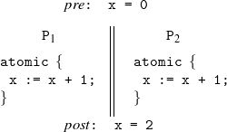
Auxiliary variables
Parallel compositional rule in itself is not complete.
Example:
- Impossible to come up with consistent rely-guar conditions which are strong enough to prove the post.
Notes:
Say why you cannot prove this pgm correct ---- no way to guarantee a thread increments a value only once !!!

Slide 9
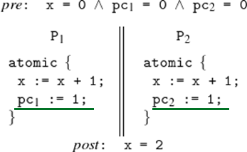
Auxiliary variables
Since auxiliary variables are not read, the semantics of the concurrent program remains unchanged.
Auxiliary variables are the local state which is required to be exposed to the environment to prove the concurrent program compositionally.
Auxiliary variables

Slide 10

Compositional Semantics wrt. Auxiliary variables
P = P₁ || P₂
- L₁, L₂ : the set of local variables of the individual threads.
- S: the set of shared variables.
- : the set of auxiliary variables.
- : local (binary) transition relations of P1 and P2
Compositional Semantics is defined by four sets:
R_{i} : Reachable state in P_{i}
Guar_{i} : Guarantee that P_{i} promises.
Notes:
Val subscripted with a particular set is the set of valuations of that set.
R1 and R2 are the reachable states tracked by the threads P1 and P2 respectively.
Guar1, Guar2 are the guarantees that P1, P2 promise. Hence it is a binary relations which captures the transformations to the shared and auxiliary state allowed by the transitions of the two threads

Slide 11
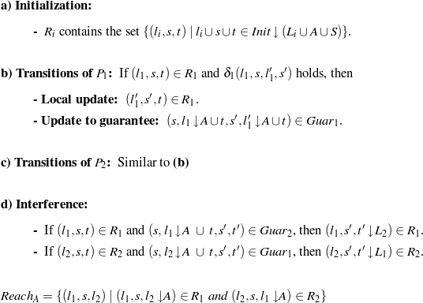
Compositional Semantics wrt. Auxiliary variables
Notes:
For every transition of thread P1 which takes local state l1 and shared state s to l1’ and s’, if (l1,s,t) in R1 then we add the tuple (l1’,s’,t) into R1.
This is local update wherein the aux state of the second thread remains unchanged and the local state and the shared state is changed according to the transitions of the first thread. Additionally we update the guarantee of the first thread Guar1 where we add the tuple which takes the shared state s and aux state compatible with l1 and t can transition to shared state s’ and aux state l1’ and t.
Lastly, if (l1,s,t) in R1 and the second thread makes a transition taking shared state s and auxiliary state compatible with l1 and t to s’ t’ then we add into R1 the state
(L1, s’, t’). Note that this is capturing the interference by the second thread wherein the local stateof the frist thread remains unchanged and the shared and aux. state is changed according to the guarantees of the second thread.

Slide 12
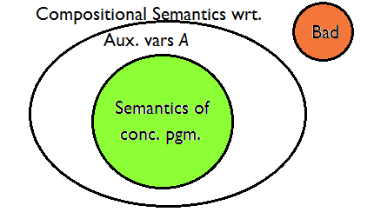
Compositional Semantics wrt. Auxiliary variables
Existence of a Jones style rely-guarantee proof →
Compositional semantics of the concurrent program with respect to the corresponding auxiliary variables is correct.
Note:
- Compositional semantics is an over-approximation of the standard operational semantics of the concurrent programs.

Slide 13
The main result
Given a concurrent program C with auxiliary variables A, we can build a sequential program S_{C,A} such that
- The compositional semantics of the concurrent program with respect to the auxiliary variables A is correct iff S_{C,A} is correct.
- At any point, the scope of S_{C,A} keeps a constant number of copies of the variables of C.
Notes:
Remind we only need aux vars to come up with the seq – do not want the proof.

Slide 14
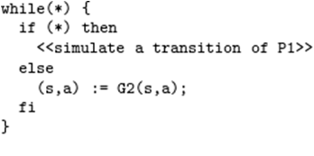
Intuition behind the sequentialization
Let there be methods G₁ and G₂ which semantically capture the guarantees Guar₁ and Guar₂ respectively.
Once we have G₂, we can compute the reachable states R₁ according to:
- Track the local state L₁, shared state and the auxiliary state of the second thread
- On two successive calls to G₂, there is no preservation of the local state of P₂.
Notes:
Seq computes the compositional semantics. This is done by having procedures for Ri’s and Guari’s as we defined them in the previous slides.
Such that the transition taking s*, a* to s, a adhere to the guarantee guar

Slide 15
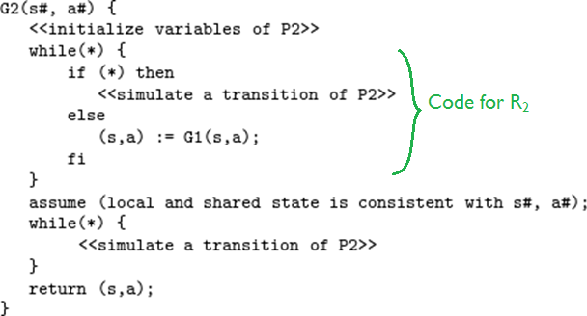
Intuition behind the sequentialization
The method G₂ (and similarly G₁) can be implemented as:
Notes:
Mutually recursive…
Local state is not preserved across two calls to G2. This is the reason why we don’t have to track the local state of both processes at
the same time leading to a sequentialization.

Slide 16
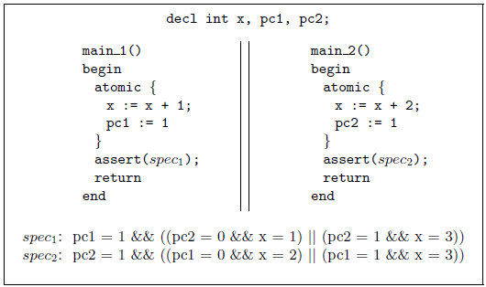
An example sequentialization
Concurrent program:

Slide 17
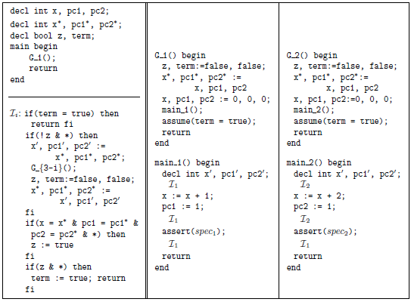
An example sequentialization

Slide 18
Applications of the theorem
Deductive verification
Predicate abstraction

Slide 19
Deductive Verification
Concurrent program C with Auxiliary variables A
➔ Sequentialization S_{C,A}
➔ Hoare-style pre-post conditions & assertions
- rely/guar → summaries of G₁ and G₂
- pre/post → pre/post conditions
- assertions → assertions
- loop invariants → loop invariants
Use deductive verification tools (like Boogie/Z3) to verify the correctness of S_{C,A} and hence the correctness of the rely/guarantee proof of C.
Jones style Rely/guarantee annotation

Slide 20
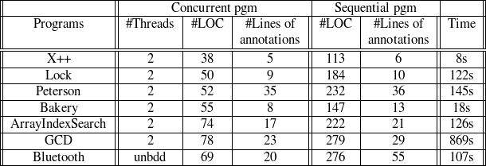
Deductive Verification
Experimental results
- Manually wrote Jones-style rely/guarantee annotations
- Boogie for Hoare-style verification of the corresponding sequential program.
- Experiments run on Intel dual-core with 1.6 GHz and 1Gb RAM.
Notes:
Emphasize bluetooth: most of the papers have tried to prove the pgm for a bounded number of threads.
Why ded ver: can be used to prove correct as it is an overapprox. And hence looked at only provability tools.

Slide 21
Predicate Abstraction
Concurrent program C + auxiliary variables A determined manually/heuristically ➔ Sequential program S_{C,A}
Use a predicate abstraction tool (like SLAM) to prove S_{C,A} and hence C correct.
- The procedure is sound but incomplete.
- If S_{C,A} cannot be proved correct, cannot deduce anything (more auxiliary variables may be needed)
We get a semi-automatic predicate abstraction tool for concurrent programs.
- Determining auxiliary variables can be automated
[Cohen-Namjoshi, Gupta-Popeea-Rybalchenko]
Used for proving programs: X++, Lock, Bakery and Peterson.
Notes:
Clearly our experiments do not strongly justify sequentializations. And whether sequentializations can be used for scalable analysis
of conc. pgms needs to be further investigated.

Slide 22
Broader context of the result
Conc. program analysis
Abstraction
Under-approx.
Over-
approx.
Finite state conc. pgm. with recursion
(multi-stack automata)
Sequentializations:
Bdd. Context Switch [LR08, LMP09]
Thread creation + Delay-bound [EQR11]
Parameterized pgm. + Bdd. rounds
Under-approx.
Compositionality
Bdd. Context Switch [QR05]
Multi-phase VPL [LMP07]
Linear interfaces [LMP10]
Graph automata [MP11]
Compositionality
Compositional Semantics → Sequentializability

Slide 23
Conclusion
Compositionality entails sequentializability.
Can be used to prove concurrent programs correct.
Our result could potentially have a number of applications:
- Deductive verification
- Predicate abstraction
- Symbolic testing
- Static analysis
Notes:
We acknowledge that our experiments are very basic and don’t fully justify sequentializations. Whether seq can be used for scalable analysis of conc programs
Needs to be further inverstigated.
We used our seq for pred abs and ded verification. But this is a more fundamental result and can have potentially more applications like symbolic testing and static analysis.

